Slide 1
Database Design

Slide 2
Database Design Workshop
Database Design
What and Why?
Requirement Gathering
Data Model
Different Data Model
Relationship Cardinality
Keys
Conceptual Data Model
Logical Data Model
Normalization
Physical Data Model
Notes:
Data modeling (data modelling) is the process of creating a data model for the data to be stored in a database.

Slide 3
Database Design
Collection of steps that help with designing, development, implementation and maintenance of data management systems.
Purpose: produce conceptual, logical and physical models of designs for the proposed database system.
Why Database Design is Important ?
Meet the requirements of the users
Avoid unnecessary redundant data
Improves data consistency
Easy to maintain
Performance
Notes:
DD - Design how data elements are correlated and what data must be stored. many people can quickly learn to implement a simple database and develop simple applications within a week or so, without giving design much thought. Why? (Can we build a house without any blueprint) Good application programs can't overcome bad database designs.
Data redundancy : same piece of data is held in two separate places.

Slide 4
Planning is the key to good database design.
Notes:
Also consistency is the key 😉
So follow standards: https://www.coding-guidelines.lftechnology.com/docs/rdbms/rdbms-naming-convention/

Slide 5
Requirement Gathering

Slide 6
Requirement Gathering
Understand the proposed system
The information needed to build a data model is gathered.
Should not define how the data will be processed but rather what the data items are, what attributes they have and how the data items are related.
The database designer need to discover/acquire all of the followings:
Entities
Attributes
Relationships
Domains
Business rules that can be enforced in the database
Establishing requirements involves consultation with, and agreement among all stakeholders.
Notes:
result of this step is a document that includes the detailed requirements

Slide 7
Requirement Gathering Techniques
Interview concerned stakeholders to understand how the business runs
Asking the Right Questions
What data is needed?
What rules govern the use of the data?
Where is the data now?
How frequently is the data stored and retrieved?
Are existing systems being replaced?
Other existing project documentations and prototypes
Requirements Gathering Sample: Link
Notes:
Purpose of the database

Slide 8
Data Modeling

Slide 9
Data Modeling
Process of creating a data model for the data to be stored in a database.
Visualizing concepts and notations for describing data, representing data relationships and data constraints.
Why is Data Modeling Important ?
Understand business processes and effectively convey important abstractions and ideas from the requirements.
Facilitate interaction between non-technical members of the organization.
Identify errors and flaws early
Notes:
Gives an idea how the final system will look like after its complete implementation.

Slide 10
Data Model
Data Model:
Abstract model that illustrates the data elements and the relationships between the data elements.
Shows how data is stored, connected, accessed and updated in the database management system.
Types of Data Models:
There are many data models being used nowadays:
Hierarchical Model
Relational Model
Entity-Relationship Model, etc.
Notes:
Q: Difference between relational model and ER Model

Slide 11
Entity-Relationship Model
High-level data model diagram.
Represent relationships between different entities.
ER diagram is used as a visual tool to represent an ER Model.
ER diagram has the following three components:
Entities: a real-world object that represents data.
Attributes: property that describes an entity
Relationship: association that exists between the entities
Different types of notations:
Crow’s Foot (IE) Notation
IDEF1X Notation
Chen ERD Notation
Notes:
For example:
If you are designing student management system:
Entities: Student, Courses, Professor
Attributes:
Students could have attributes like roll_no, name, address, phone_number and so on
Courses could have attributes like course_id, course_name, course_desc and so on
Professor could have attributes like prof_id, prof_name, salary and so on
Relationship: how are student, courses and professor entities related? Is it 1:1, 1:M or M:N?
Domain is a set of possible values permitted for an attribute in a table: professors have “salutation” attribute, declared as string data type and only allows code values: “Mr.”, “Mrs.”, “Ms.”. The domain for the salutation attribute is: “Mr.”, “Mrs.”, “Ms.”.
Business rules: the distinguishing characteristics of data that can be enforced in the database: Students must have std_id and at least 1 address, A course must be taught by a professor

Slide 12
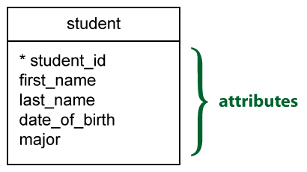
Crow’s Foot (IE) Notation
Also known as Information Engineering
Entity is represented by a rectangle, with its name in the top section
Attributes are listed in the second section of the box. To mark the attribute that acts as an identifier, an asterisk (*) is used at the front of the attribute.
A relationship is represented by a solid line. Usually, each relationship has a name written on the relationship line. This describes what kind of relationship connects the objects.

Slide 13
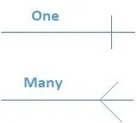
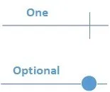
Crow’s Foot (IE) Notation
IE has a set of symbols to indicate the cardinality and modality of the data in the relationships.
Cardinality (Upper bound)
The maximum number of times an instance in one entity can be associated with instances in the related entity.
Can be 1 or many
Modality (Lower bound)
The minimum number of times an instance in one entity can be associated with an instance in the related entity.

Slide 14
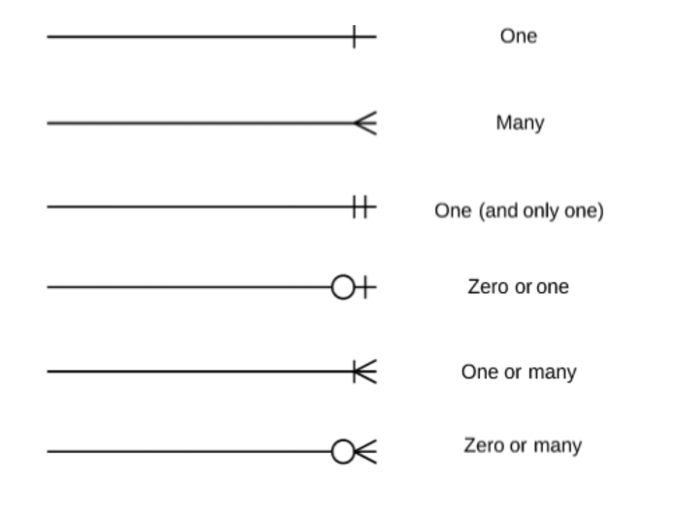
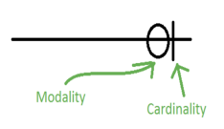
Crow’s Foot (IE) Notation
Cardinality and modality are indicated at both ends of the relationship line. Once this has been done, the relationships are read as being 1 to 1 (1:1), 1 to many (1:M), or many to many (M:N).
Notes:
Research on when One & One (and only one) type of cardinality is used.

Slide 15
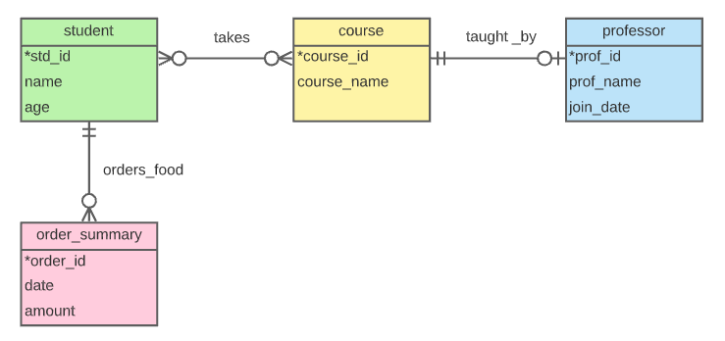
ER-Diagram
Assignment: Convert this diagram using Chen Notation and IDEF1X notation.
Notes:
Q1: What will be the relationship between student and course if business rule updated as: course will only exist if students are willing to enroll into. I don’t want course to exist if no students are enrolled in it.
Q2: Starting now when a new student registered, they have to choose a course
Q3: How do you relate student and professor?
Q4: Business rule changed to 1 (and only 1) to Many (1 or many). How do you relate student and professor in this case?

Slide 16
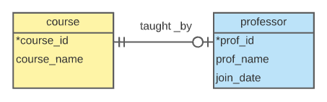
Types of Relationship
Database relationships are associations between tables that are created using join statements to retrieve data.
1-to-1 (1:1)
Each record in Table A relates to one record in Table B, and each record in Table B relates to one record in Table A.
Each primary key value relates to none or only one record in the related table.
Notes:
PK and foreign key with UNIQUE constraint can be used to implement this in database tables.

Slide 17
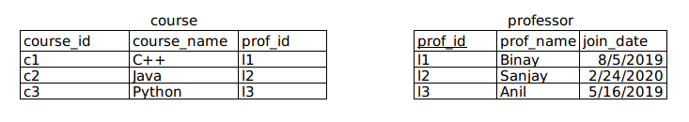
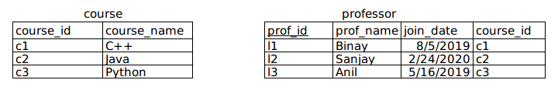
Types of Relationship: 1-to-1 (1:1)
Representing above diagram in relational table:
Or,
Notes:
Which table’s PK will be referenced by another table as foreign key?

Slide 18
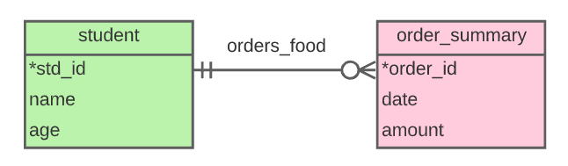
Types of Relationship: 1-to-many (1:M)
1-to-many (1:M)
A record in Table A can relate to zero, one, or many records in Table B. Many records in Table B can relate to one record in Table A.
Notes:
PK → Foreign Key ( Optional then Nullable column; If mandatory then Not NULL)

Slide 19
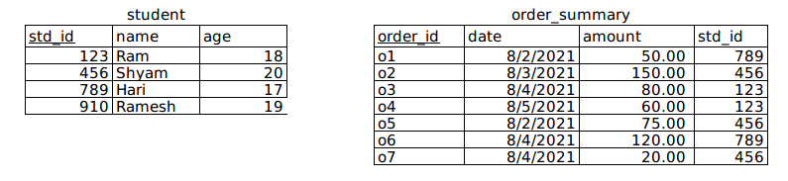
Types of Relationship: 1-to-many (1:M)
Representing above diagram in relational table:

Slide 20
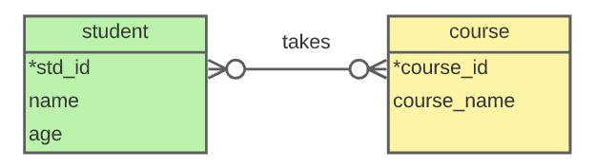
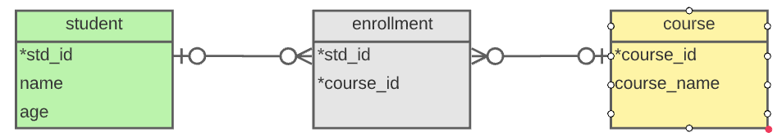
Types of Relationship: Many-to-many (M:N)
Many-to-many (M:N)
Each record in both tables can relate to none or any number of records in the other table.
The usual solution is to break this relationship down into two one-to-many relationships by creating a linking table.

Slide 21
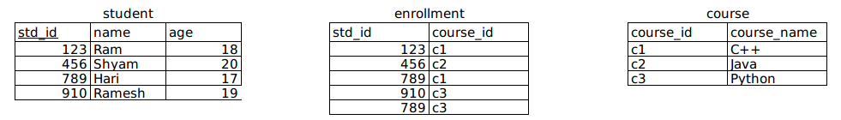
Types of Relationship: Many-to-many (M:N)
Representing above diagram in relational table:
Notes:
Why linking table is required?
We can’t add the primary key of one table into the other, or both, because this only stores a single relationship, and we need many.
This would mean we have one column for storing multiple values, which is very hard for maintenance and querying.

Slide 22
Assignment
Choose any 2 domains and gather requirements for the system to be built.
Domains:
Nepal Football League
Car Dealership and Parts
Employee Recruitment and Training
Health Care
Create a Crow’s Foot ERD for each of the following descriptions.
Questions will be provided separately.
Ecommerce
Food Delivery System
Travel Agency
Book Publishing House
Notes:
Proper documentation of requirements gathering is required, No standard for documentation
At least 2 domain required, but if someone is interested in all domain, then why not
ER modeling for the questions provided
Other modeling
Research on edge case in relationships

Slide 23
Example Scenario
I want to create a music streaming service where users can sign up for free. Users can listen to the songs that are uploaded by the artists. Users can create multiple playlists and each playlist can have multiple numbers of songs. A playlist can only be owned by a single user. An artist can either have a single release or have an album containing several songs. A song could only appear in one album. Songs can be categorized based on their genre.
Users need to be able to save its preferences such as language, theme while using the service.

